Slide 1
Welcome to
Math & Logic!

Slide 2
Review: What did we do in class last time?
Preview: How are set operations related to logical connectives?
Notes:
Review: Test on Sets & Heuristics
Preview: union conjunction or; intersection disjunction and; complement negation not

Slide 3
Logic
Competency: Apply symbolic logic principles
Conjunction, Disjunction, Negation
Truth Tables: AND, OR, NOT, NAND, NOR, XOR

Slide 4
Simple and Compound Statements
In symbolic logic, letters are use for simple statements, usually starting with p, q, and r.

Slide 5
Simple and Compound Statements
In symbolic logic, letters are use for simple statements, usually starting with p, q, and r.
Conjunction: p∧q p AND q
Disjunction: p∨q p OR q
Negation: ~p NOT p

Slide 6
Truth Tables: AND, OR, NOT
Notes:
See the first half of Intro to Truth Tables with Tricia

Slide 7
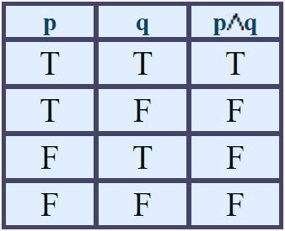
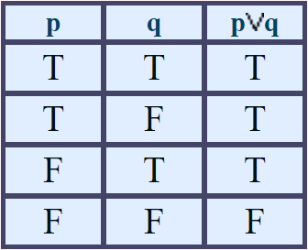
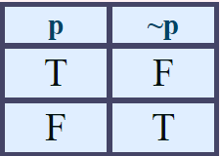
Truth Tables: AND, OR, NOT

Slide 8
Truth Tables: NAND, NOR, XOR
NAND: p ⊼ q
NOR: p ⊽ q
XOR: p ⊻ q (sometimes EOR, EXOR)

Slide 9
Truth Tables: NAND, NOR, XOR
Notes:
See the second half of Intro to Truth Tables with Tricia

Slide 10
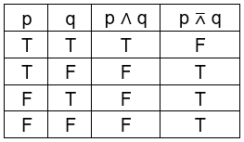
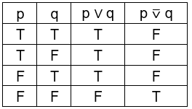
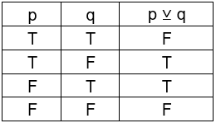
Truth Tables: NAND, NOR, XOR

Slide 11
Contradiction; Tautology
A statement that is false in every case is called a contradiction. c
A statement that is true in every case is called a tautology. t

Slide 12
Truth Tables
Let’s practice now!
Truth Tables Practice Key
Notes:
See More Truth Tables with Tricia

Slide 13
Review
Conjunction, Disjunction, Negation
Truth Tables: AND, OR, NOT, NAND, NOR, XOR

Slide 14
To Do:
Truth Table Quiz
Crash Course 21
Crash Course 22

Slide 15
Have a great day!
And remember that every day
at CVTC is a great day!

